Slide 1


Lampros Velentzas
7-Mar-2025

Slide 2

Outline
Executive Summary
Introduction
Methodology
Results
Conclusion
Appendix

Slide 3
Executive Summary
Summary of methodologies
Data collection: Scraped SpaceX launch data from SpaceX API and Wikipedia
Data Wrangling & Cleaning: Processed missing values, engineered key features (launch site, payload mass, booster version etc.)
Exploratory Data Analysis (EDA):
Visualized trends in launch success rates over time
Analyzed impact of launch site, payload mass and booster version
Machine Learning
Built classification models (Logistic Regression, Decision Trees, SVM, KNN)
Selected best-performing model based on accuracy, precision, recall and F1-score
Key findindings & Results
Landing Success Rate: Identified key factors influencing booster landings
Best Model Performance: Decision Tree achieved 88.93% accuracy in predicting successful landings
Key Predictors:
Payload mass has a non-linear impact on landing success
Certain launch sites have higher success rates
Newer booster versions show improved reliability
Business Impact: Model can help SpaceX optimize launch decisions, reducing mission costs

Slide 4
Introduction
Project background and context
SpaceX has revolutionized the aerospace industry by successfully launching and landing reusable rockets, significantly reducing space exploration costs. The Falcon 9 first-stage booster landing is a key milestone in ensuring the reusability of rockets, making space missions more economical and sustainable. However, predicting the success of the booster landing remains a complex task, as many factors affect the outcome, such as payload mass, booster version, weather conditions, and launch site.
As SpaceX aims to increase the frequency and reliability of their launches, a data-driven approach is crucial in predicting the success or failure of these landings. This project focuses on analyzing historical launch data to build a predictive model that can forecast the success of a Falcon 9 first-stage landing.
Problem Statement & Objectives
The primary problem addressed in this project is to predict whether the Falcon 9 first-stage booster will successfully land after launch. Specifically, we aim to:
Identify key factors that influence the likelihood of a successful booster landing.
Build a predictive model that can accurately classify the success or failure of the landing, based on historical launch data.
Evaluate the performance of several machine learning models to determine the best approach for prediction.
By tackling these questions, the project aims to inform future SpaceX missions and improve decision-making regarding rocket reuse, ultimately contributing to cost savings and efficiency.

Slide 5

Section 1

Slide 6
Methodology
Executive Summary
Data collection methodology:
Requests to the SpaceX API
Web scraping Falcon 9 and Falcon Heavy Launches Records from Wikipedia
Perform data wrangling
Using pandas performed standard data wrangling operations
Perform exploratory data analysis (EDA) using visualization and SQL
Perform interactive visual analytics using Folium and Plotly Dash
Perform predictive analysis using classification models

Slide 7
Data Collection – SpaceX API
Request the json payload via an API call from SpaceX API
Decode the response and turn it to a pandas df
Use helper functions to extract additional information
Filter df to only include Falcon 9 launches
Use mean() to replace ‘PayloadMass’ nulls
requests.get(spacex_url)
pd.json_normalize(response)
getBoosterVersion(), getLaunchSite(), getPayloadData(), getCoreData()
Df[df[‘BoosterVersion’] == ‘Falcon 9’
df[‘PayloadMass’].mean()
https://github.com/Labrosvel/Data-Scientist-Capstone/blob/main/Lab1a-spacex-data-collection-api.ipynb

Slide 8
Data Collection - Scraping
Perform an HTTP GET method to request the Falcon9 Launch HTML page, as an HTTP response.
Create a BeatifulSoup object from the HTML response
Extract all column/variable names from the HTML table header
Create a df by parsing the data from the table
requests.get(wiki_url).text
html_table.find_all(‘th’)
html_table.find_all(‘tr’)
https://github.com/Labrosvel/Data-Scientist-Capstone/blob/main/Lab1b-webscraping.ipynb

Slide 9
Data Wrangling
Calculate the number of launches on each site
Calculate the number of occurrence of each orbit
Calculate the number and occurrence of mission outcome of the orbits
Create a landing outcome label from Outcome column
df['LaunchSite'].value_counts( )
df['Orbit'].value_counts( )
df['Outcome'].value_counts( )
np.where(df['Outcome'].isin(bad_outcomes),0,1)
https://github.com/Labrosvel/Data-Scientist-Capstone/blob/main/Lab1c-spacex-Data%20wrangling.ipynb

Slide 10
EDA with Data Visualization
Used scatterplot of ‘Flight Number’ vs ‘Launch Site’ to identify whether there are patterns that affect the outcome
Used scatterplot of ‘Payload’ vs ‘Launch Site’ to identify whether there are patterns that affect the outcome
Used barplot of ‘Success Rate’ vs ‘Orbit Type’ to identify whether there are orbits with higher success rate than others
Used scatterplot of ‘Flight Number’ vs ‘Orbit Type’ to identify patterns
Used scatterplot of ‘Payload’ vs ‘Orbit Type to identify patterns
Used line plot of ‘Year’ vs ‘Success Rate’ to identify potential trend
https://github.com/Labrosvel/Data-Scientist-Capstone/blob/main/Lab2b-edadataviz.ipynb

Slide 11
EDA with SQL
Identified the names of the unique launch sites
Displayed 5 records where launch sites begin with the string ‘CCA’
Identified the total payload mass carried by boosters launched by ‘NASA (CRS)’
Identified the average payload mass carried by booster version F9 v1.1
Listed the date when the first successful landing outcome in ground pad was achieved
Listed the names of boosters which have successfully landed on drone ship and had payload mass greater than 4000 kg but less than 6000 kg
Listed the total number of successful and failure mission outcomes
Listed the names of the boosters which have carried the maximum payload mass
Listed the failed landing outcomes in drone ship, their booster versions, and launch site names for in year 2015
Ranked the count of landing outcomes (such as Failure (drone ship) and Success (ground pad)) between the date 2010-06-04 and 2017-03-20, in descending order
https://github.com/Labrosvel/Data-Scientist-Capstone/blob/main/Lab2a-eda-sql-coursera_sqllite.ipynb

Slide 12
Build an Interactive Map with Folium
Created a folium Map object, with initially centered location to be NASA Johnson Space Center at Houston, Texas.
Added a folium.Circle (adds small yellow circle) and folium.Marker (to display name of the site) for each launch site on the map
Used Marker object to color green for successful and red for failed launches
Used MarkerCluster( ) to simplify the map which contains many markers with the same coordinates (for the same site)
Used Marker to apply color label and easily identify which launch sites have relatively high success rates
Used MousePosition() on the map to get coordinate for mouse over a point on the map
Used icon property DivIcon() to display the distance between coastline point and launch site
Used folium.PolyLine to update the map with the distance line
https://github.com/Labrosvel/Data-Scientist-Capstone/blob/main/Lab3a-launch_site_location_Folium.ipynb

Slide 13
Build a Dashboard with Plotly Dash
Used Pie-charts to visualize
Success launches by site over total
Success vs Failure rate per site
Used colored scatter-plot to identify success over payload mass and booster version
Used dropdown to add interactivity for both charts to select amongst Launch Sites or even all of them
Used slider to add interactivity for scatter plot to filter across different payload ranges
https://github.com/Labrosvel/Data-Scientist-Capstone/blob/main/Lab3b-Interactive_Dashboard_Plotly_Dash.txt

Slide 14
Predictive Analysis (Classification)
Created the ‘Class’ array using to_numpy() method
Standardised the training data using StandardScaler() and fit_transform()
Split the data into train and test data using train_test_split()
Built the algorithms (logistic regression, SVM, decision tree, KNN) with GridSearchCV object, parameters dictionary and 10-fold crossvalidation.
Train the model with .fit() function
Used attribute best_score() to calculate the accuracy of the model
Compared accuracies across models for the test set
Y = data[‘Class’].to_numpy( )
Preprocessing.StandardScaler.fit_transform(X)
Train_test_split(X, Y, test_size=0.2)
GridSearchCV(estimator, param_grid, cv=10)
Model.fit(X_train, Y_train)
Model.best_score_
https://github.com/Labrosvel/Data-Scientist-Capstone/blob/main/Lab4a-SpaceX_Machine%20Learning%20Prediction.ipynb

Slide 15
Results
Exploratory data analysis results
Interactive analytics demo in screenshots
Predictive analysis results

Slide 16

Section 2

Slide 17
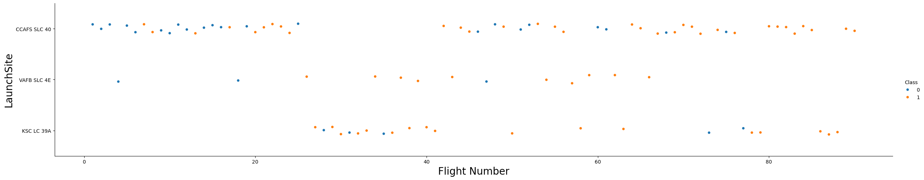
Flight Number vs. Launch Site
We can identify from the plot the following patterns:
‘VAFB SLC 4E’ site hasn’t had any launches since around 65th flight
‘CCAFS SLC 40’ site has more launches than the others
Most recent flights had successful landings, especially after the 80th flight all landed successfully

Slide 18
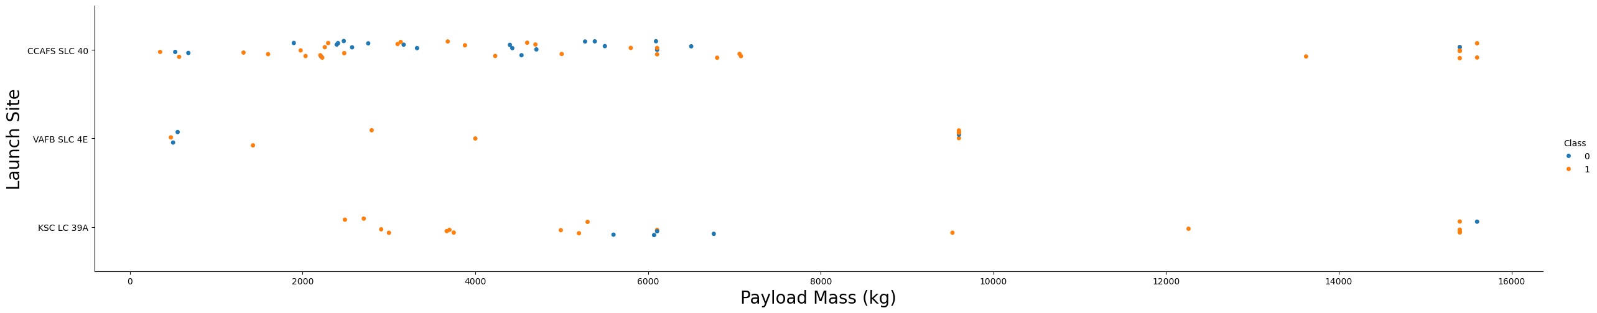
Payload vs. Launch Site
We can identify from the plot that:
The VAFB-SLC launch site has no rockets launched for heavy payload mass (greater than 10000).

Slide 19
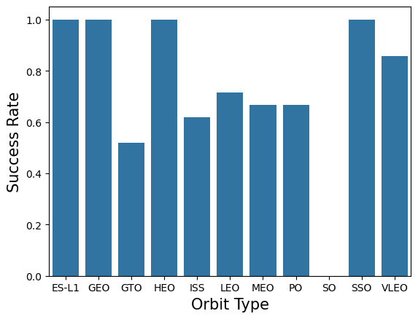
Success Rate vs. Orbit Type
We can identify from the plot that:
Orbit types: ‘ES-L1’, ‘GEO’, ‘HEO’ and ‘SSO’ have 100% second stage recovery
All other orbits have success rate higher than 50%
‘GTO’ orbit has the lowest success rate
There is no data related to ‘SO’ orbit

Slide 20
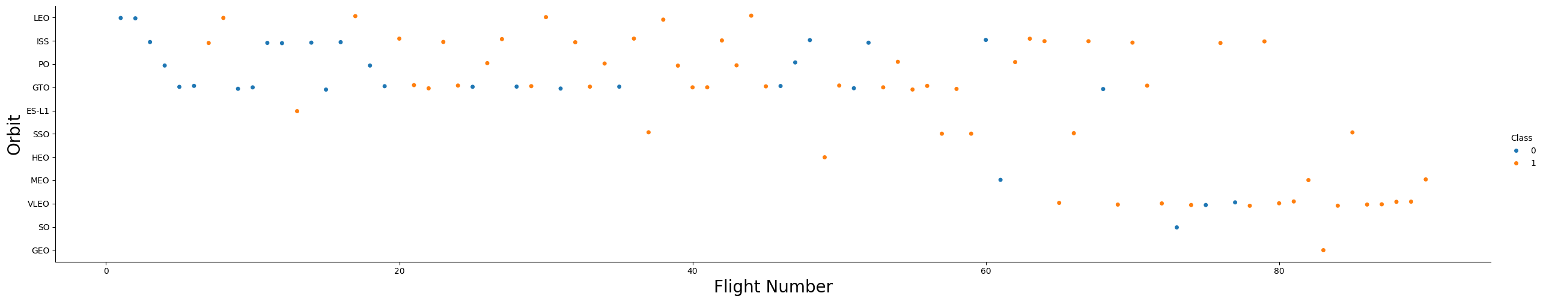
Flight Number vs. Orbit Type
We can identify from the plot that:
In the LEO orbit, success seems to be related to the number of flights.
In the GTO orbit, there appears to be no relationship between flight number and success.

Slide 21
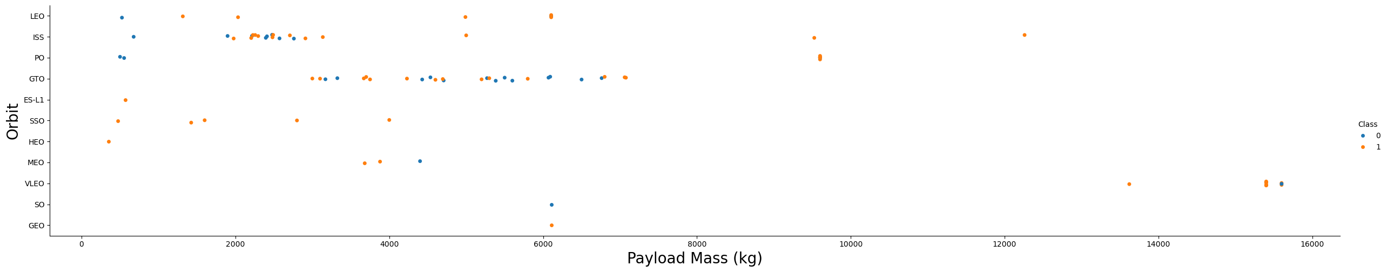
Payload vs. Orbit Type
We can identify from the plot that:
With heavy payloads the successful landing or positive landing rate are more for Polar, LEO and ISS.
However, for GTO, it's difficult to distinguish between successful and unsuccessful landings as both outcomes are present.

Slide 22
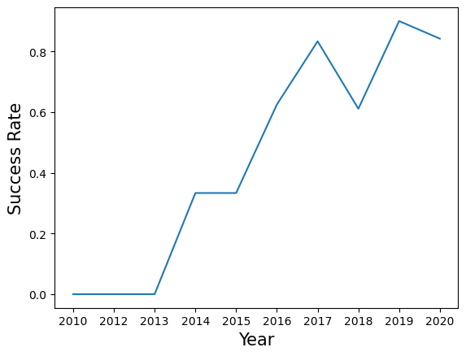
Launch Success Yearly Trend
We can identify from the plot that:
The success rate since 2013 kept increasing till 2020

Slide 23
All Launch Site Names
The names of the unique launch sites are:
CCAFS LC-40
VAFB SLC-4E
KSC LC-39A
CCAFS SLC-40

Slide 24
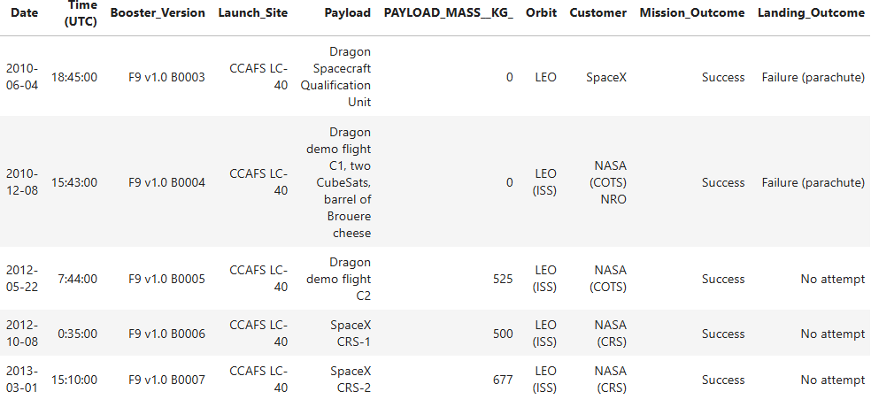
Launch Site Names Begin with 'CCA’ (sample)

Slide 25
Total Payload Mass
The total payload carried by boosters from ‘NASA (CRS)’ was: 45,596kg

Slide 26
Average Payload Mass by F9 v1.1
The average payload mass carried by booster version F9 v1.1 was: 2928.4kg

Slide 27
First Successful Ground Landing Date
The first successful landing outcome in ground pad was achieved on: 8th-Apr-2016

Slide 28
Successful Drone Ship Landing with Payload between 4000 and 6000
The names of boosters which have successfully landed on drone ship and had payload mass greater than 4000 but less than 6000 is:
F9 FT B1022
F9 FT B1026
F9 FT B1021.2
F9 FT B1031.2

Slide 29
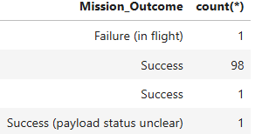
Total Number of Successful and Failure Mission Outcomes
The total number of successful and failure mission outcomes is presented in the following table:

Slide 30
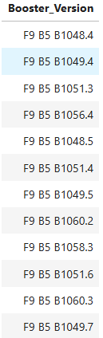
Boosters Carried Maximum Payload
The names of the boosters which have carried the maximum payload mass are presented in the following table:

Slide 31
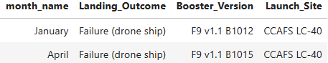
2015 Launch Records
The failed landing_outcomes in drone ship, their booster versions, and launch site names for in year 2015 are presented in the following table:

Slide 32
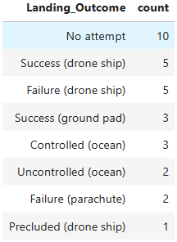
Rank Landing Outcomes Between 2010-06-04 and 2017-03-20
The ranking of the count of landing outcomes (such as Failure (drone ship) or Success (ground pad)) between the date 2010-06-04 and 2017-03-20, in descending order are presented in the following table:

Slide 33

Section 3

Slide 34
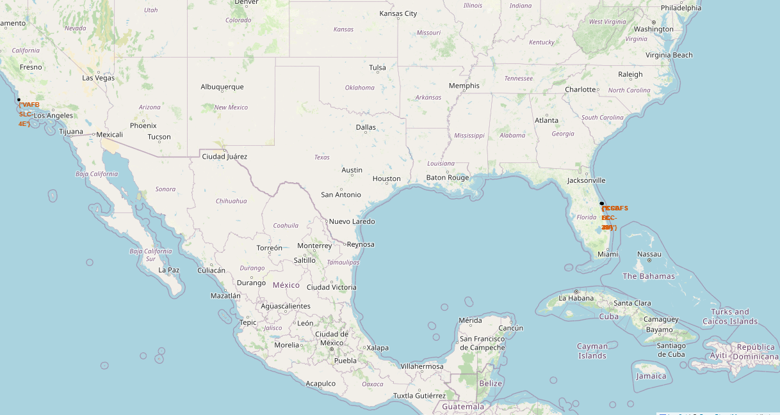
Launch sites on a map
Findings:
There are 4 launch sites.
All launch sites are close to the coast. One is close to west coast and the other three are close to the east coast and very close together
No particular proximity to the Equator line

Slide 35
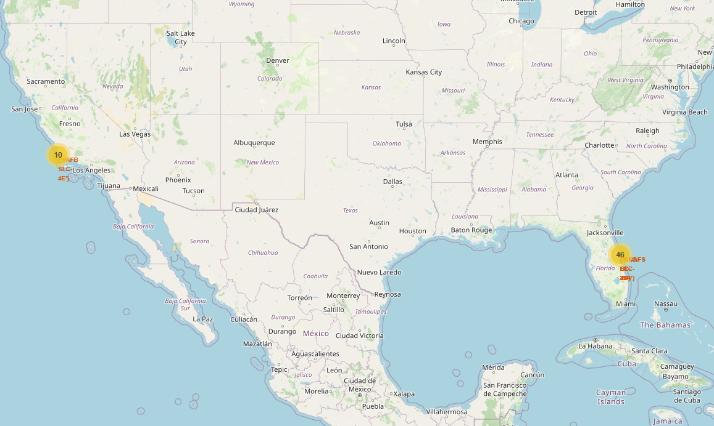
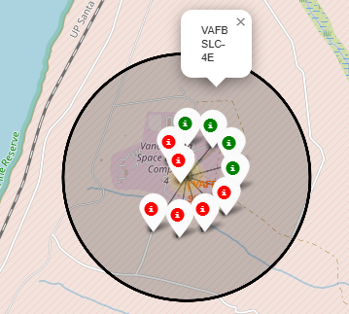
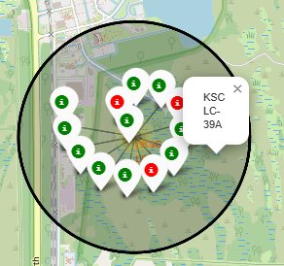
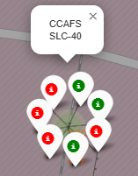
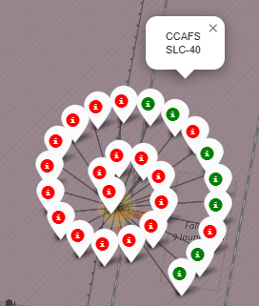
Colour labeled outcomes on a map
VAFB SLC-4E launch site has 10 launches with not good success rate
KSC LC-39A site has good success rate
CCAFS SLC-40 site has very low success rate

Slide 36
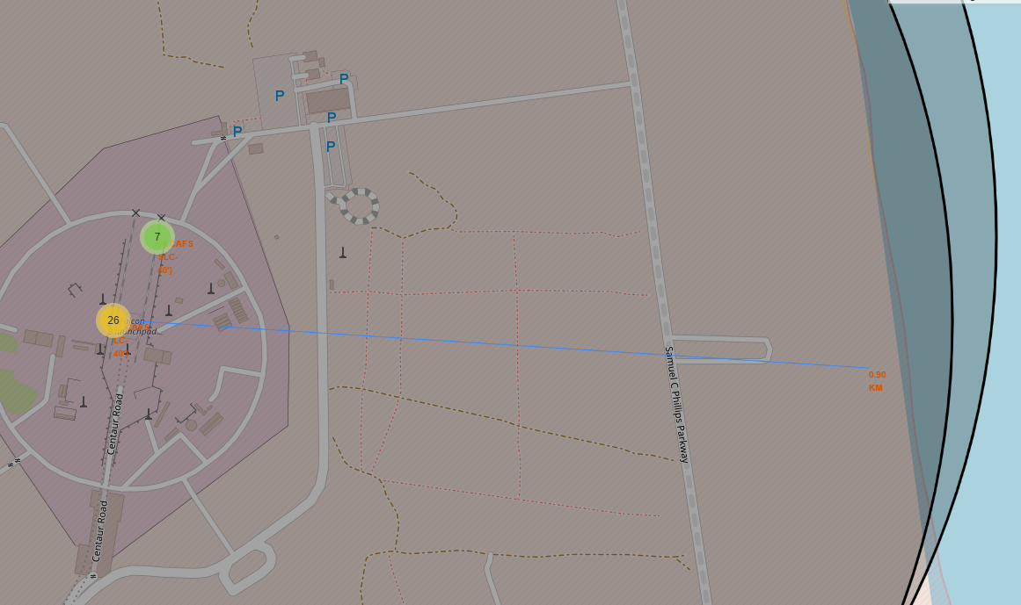
Distance between launch site and its proximities
CCAFS SLC-40 site distance from the coastline is approximately 0.90km

Slide 37

Section 4

Slide 38
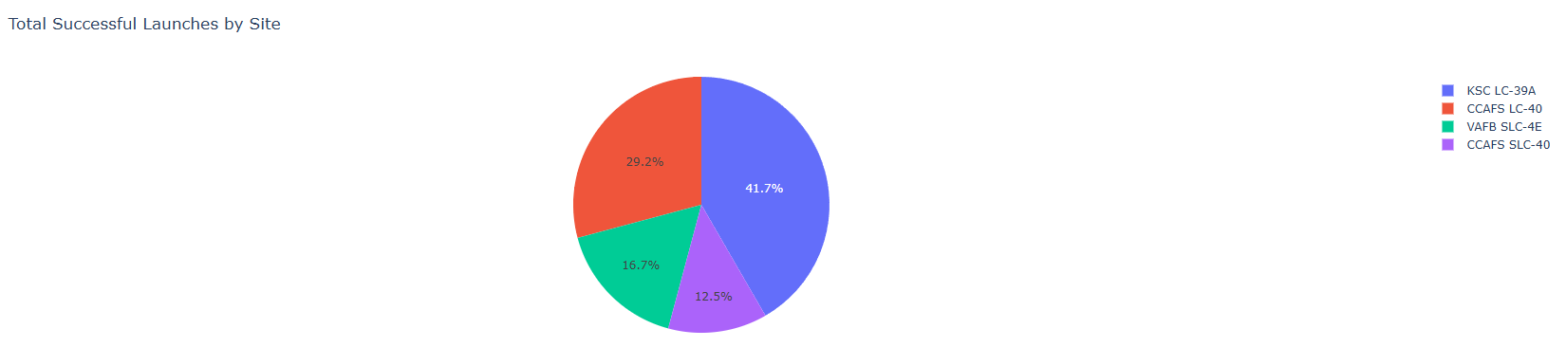
Total Successful Launches by Site
Findings:
KSC LC-39A has the most successful launches, more than 40% of all
CCAFS SLC-40 has the least successful launches of all, around 12.5% of them

Slide 39
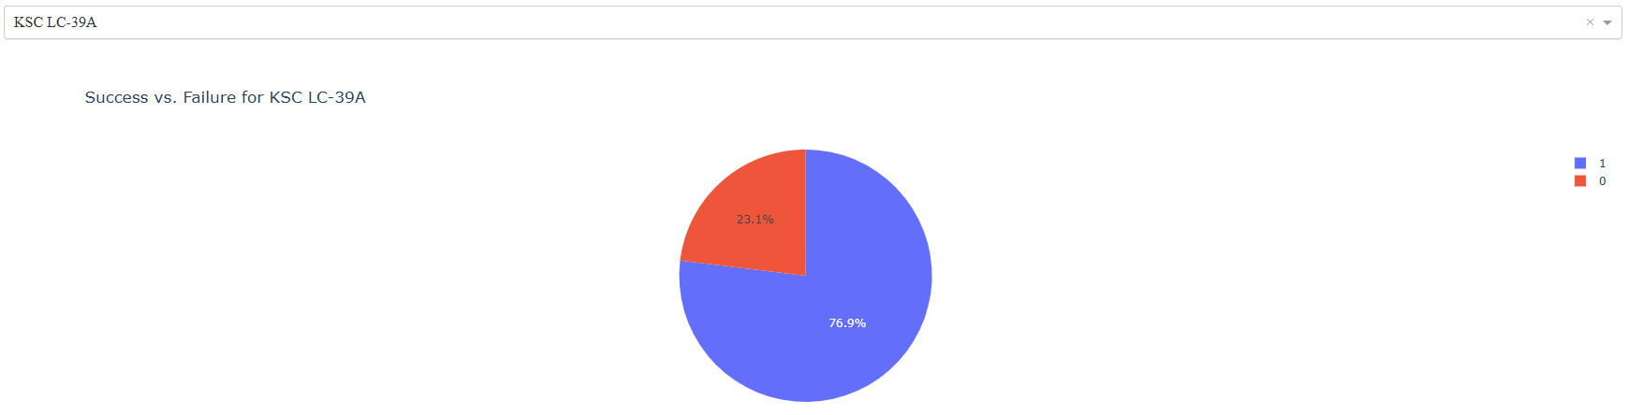
Highest Success Rate Launch Site
Findings:
KSC LC-39A has also the highest success rate with 76.9% of launches from this site recovering the booster

Slide 40
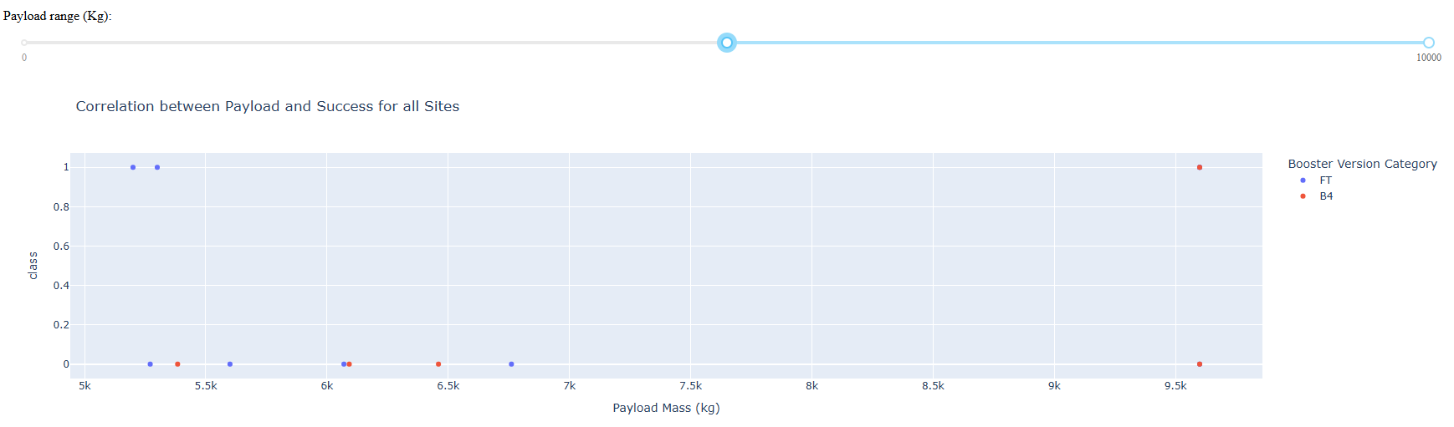
Correlation between Payload (>6000kg) and Success
Findings:
Only FT and B4 boosters weigh 5000kg or more
FT boosters have higher success rate than B4 ones. B4s are rarely recovered (20%)
Only two boosters were above 7000kg, both were B4 and only one recovered

Slide 41

Section 5

Slide 42
Classification Accuracy
Accuracy results:
Logistic regression: 83.33%
SVM: 83.33%
Decision Tree: 88.89%
KNN: 83.33%
Champion model
Decision tree: 88.89% accuracy

Slide 43
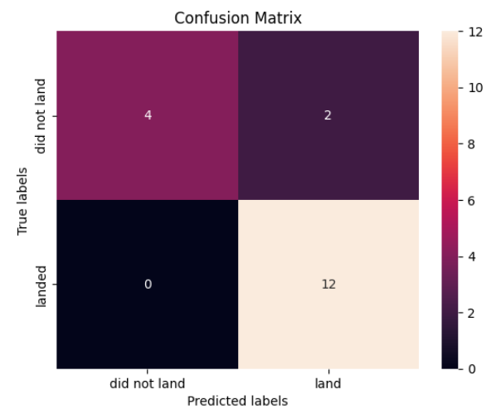
Confusion Matrix (Decision Tree)
Findings:
Decision tree has TP rate of 100% identifying all successful landings
Decision tree identifies 4 out 6 failures. Decision Tree has better accuracy than the other algorithms that identify 3/6 failures.

Slide 44
Conclusions
Key factors affecting landing success
Certain launch sites have significantly higher success rate (e.g. KSC LC-39A)
Booster versions play a crucial role – newer models tend to have higher landing success
Payload mass affects landing success, with heavier payloads reducing the probability of a successful landing
Machine Learning Model Performance
Amongst the tested models (logistic regression, decision trees, SVM, KNN), the best-performing model achieved 88.89% accuracy
Feature importance analysis showed that launch site, booster version, and payload mass were the most influential predictors.
Business Impact and Future Applications
The predictive model provides insights that can help SpaceX optimize launch conditions and reduce mission costs by improving landing success rates
The methodology can be extended to other aerospace companies looking to develop reusable rocket technology.

Slide 45
Appendix
Include any relevant assets like Python code snippets, SQL queries, charts, Notebook outputs, or data sets that you may have created during this project

Slide 46


